Slide 2
Top 10 Ways to Fail at DevOps
November 2016
Scott Willson – Mktg. Dir. – ARA / DevOps

Slide 3

DevOps Definition
Top Ten List

Slide 4
DevOps is a…
Gartner – 2014 Cool Vendors in DevOps
DevOps is a philosophy (not a market). There are no rules, no manuals, only guidelines.
Notes:
DevOps is a philosophy of collaboration and a culture of communication and trust. It is inclusive and not exclusive.

Slide 5
10. Application Release Automation Tools
Gartner – 2016 Application Release Automation MQ
ARA tools are a key part of enabling the DevOps goal of achieving continuous delivery with large numbers of rapid, small releases.
Forrester – 2016 Vendor Landscape: ARA Tools
ARA tools help firms release software consistently and in an automated fashion as a key part of getting business technology solutions to end customers.

Slide 6
9. Failing To Include Management Buy-in

Slide 7
8. Become Too Reliant on OSS

Slide 8
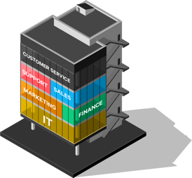

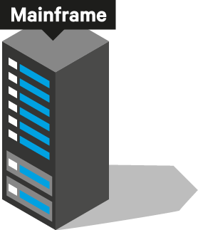

7. Failing to Consider IT History
Notes:
If the history of IT has taught us anything it projects that microservices, containers and cloud computing will not replace all of IT, but just be one more thing that IT must manage. DevOps must take the growing diversity of the IT portfolio into account.
Describe the progression on the next “animated” slides.

Slide 9
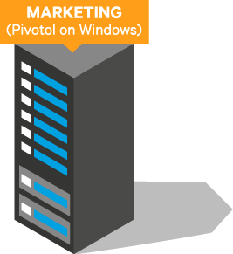
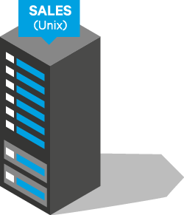
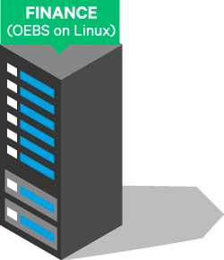
7. Failing to Consider IT History

Slide 10





7. Failing to Consider IT History

Slide 11




7. Failing to Consider IT History

Slide 12
7. Failing to Consider IT History

Slide 13
6. Boxing Yourself In
Expanding DevOps and Continuous Delivery Use Case
Mainframe & Legacy Systems/Teams
Core Backend COTS Apps
DevOps Orchestration
QA, SecOps, DBAs, etc…
DevOps toolchain
Flexibility
Tech Stack Agnosticism
Sophisticated Controls, Calendaring & Scaling
in

Slide 14
5. Standardizing on Unproven Languages
http://www.zdnet.com/article/which-programming-languages-are-most-popular-and-what-does-that-even-mean/

Slide 15
4. Centralize DevOps

Slide 16
3. Think it is OK to Fail (in PROD)

Slide 17
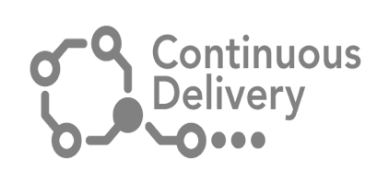
2. Begin With the End in Mind – PROD CD Automation
Use Same Automation Mechanics for Every Environment
DEV is Deployed to All the Time
QA - Less Often
PRE-PROD - Even Less Often
PROD - Less Frequently Still
Humble, J., & Farley, D. (2011). Ch. 5. In Continuous Delivery (p. 115).

Slide 18
1. DevOps = DevNo-Ops – The Case for AgileOps
DevOps = Agile Ops
PROD Support
DEV/QA Support
Business Needs
Release Management
Help Desk
COTS Install/Config.
App Monitoring
Outages
Infrastructure Phys./VM
Network Maintenance
DEV/QA
CI
QA
Provision
Deploy
Ops
Project/Pipeline Driven
Interrupt Driven
Notes:
Read the list. There are lots of requests and distractions and interrupt Ops on a daily basis. They do not have time to participate in transformative work like DevOps – they are too busy keeping the lights on.
When executives and upper management ask what DevOps is, it is helpful to define it as Agile Ops. If Ops best practices are not automated and personnel freed to participate in pipeline tasks, you will fail at DevOps.

Slide 19
Thank You!
e: scott.willson@automic.com
t: @rscottwillson
l: https://www.linkedin.com/in/swillson

